Slide 1
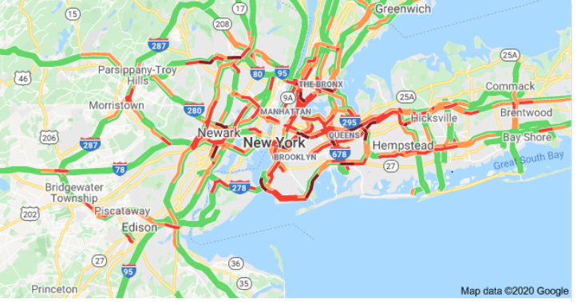
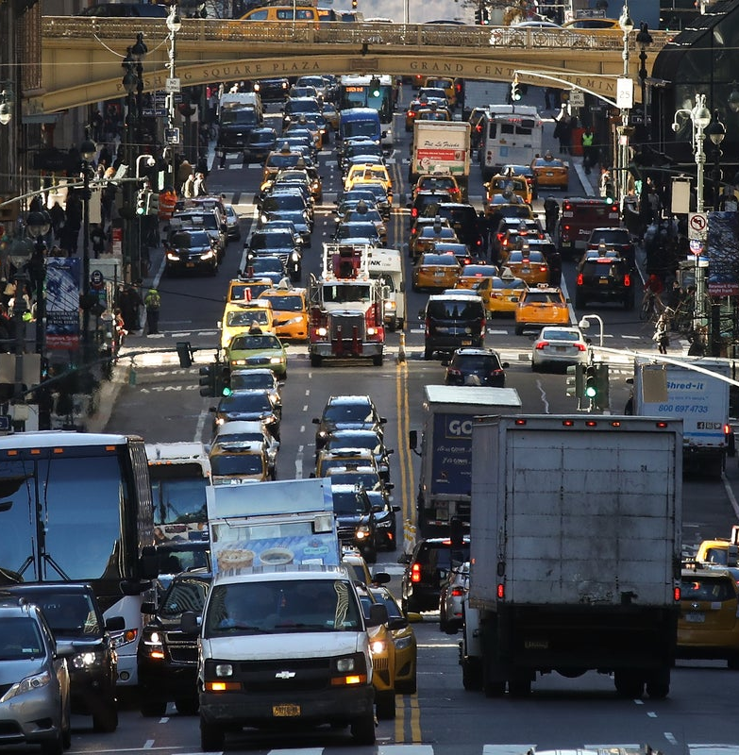
Traffic Congestion Problem in New York City

Slide 2


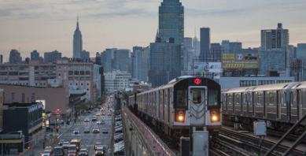

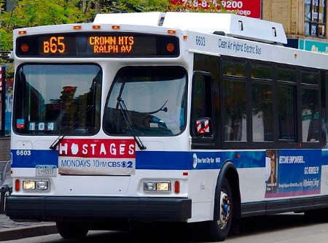

Background
Starting in 2013, came For Hire Vehicles ( FHVs ), began with Uber and Lyft
2013
Public Subway
Public Buses
Private-Taxi and Limousine services
Impact
Market Share for Yellow and Green dropped significantly
Public transportation use dropped significantly
Congestion within the streets of Manhattan rose significantly leading to noticeable economic damage
Yellow cab’s drop in market share created many hardships for individual drivers

Slide 3
City of NYC
FHV
Congestion charges
Limit Licenses
Convenience
Ride-sharing
More informed decisions
Ecosystem
Customers
G/Y Taxi
Cab drivers

Slide 4




Data Gathering
Yellow-Green-FHV Taxi Aggregated data
Yellow-Green Taxi individual datasets
NYC public-transport usage data
Uber 2015-2016 data
Used aggregated data to analyze over the year trends for the number of trips, avg minutes per trip, unique vehicles per month, etc
Used 1 million trips sample each from individual yellow, green and Uber to calculate the statistics across timeframes like avg trips and duration in the morning rush, afternoon, evening and nighttime to do the analysis across the timeframes
Used public transport data to analyze the trend over the last few years
Analyzed the pickups and drop-offs on maps using 1 million samples each from Yellow and Green

Slide 5
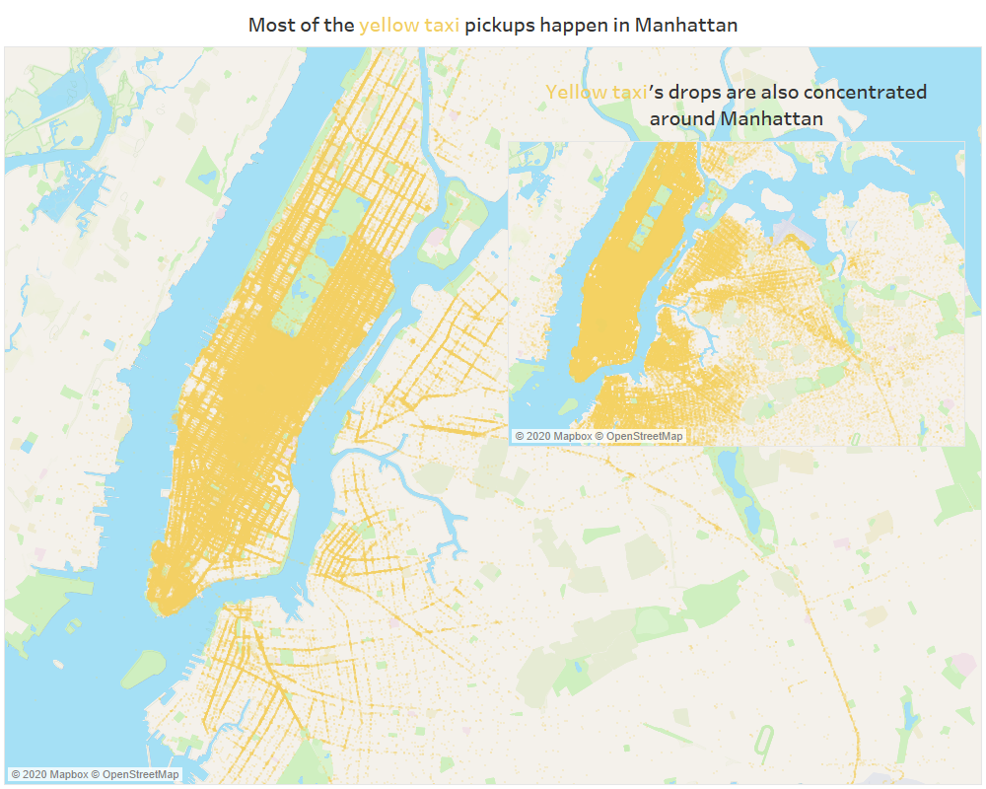
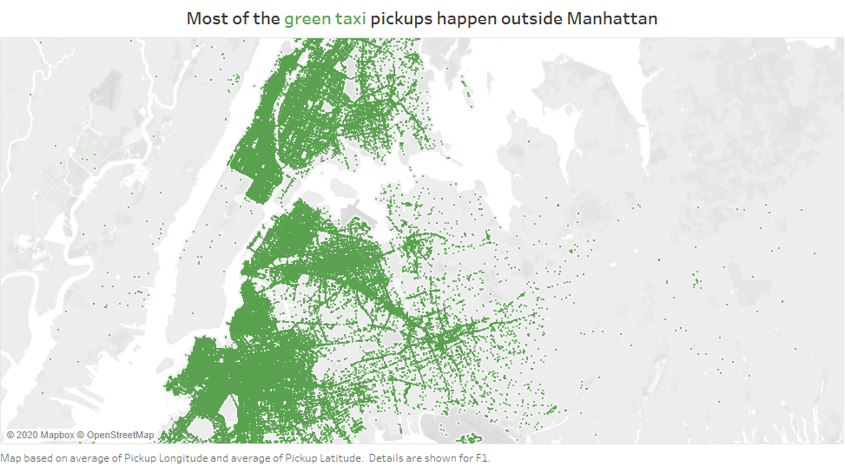
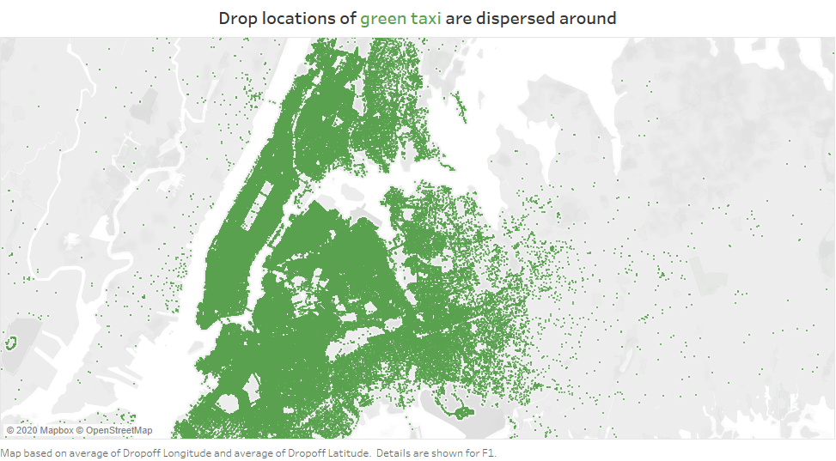

Slide 6
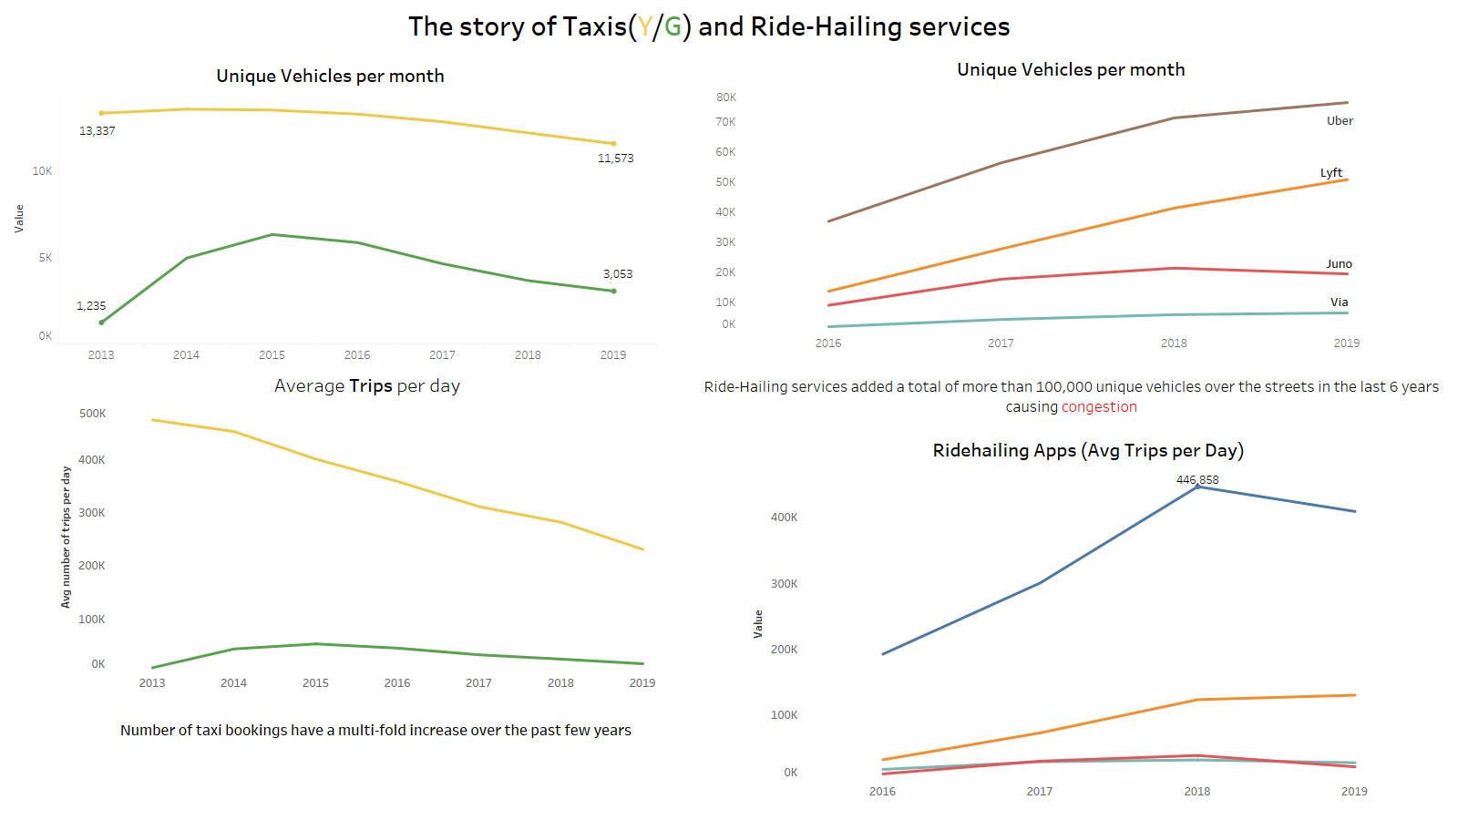

Slide 7
Deconstructing Congestion: Primary factors
Cruising Time
Decline in Public Transportation
Number of Taxis on Road

Slide 8
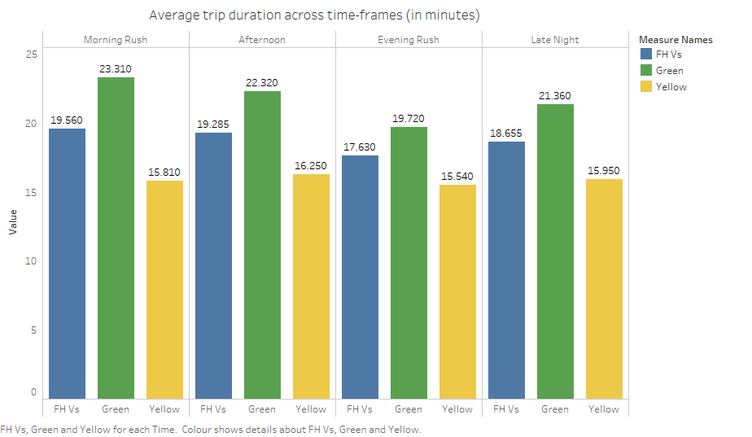
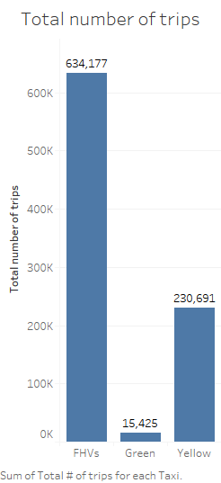
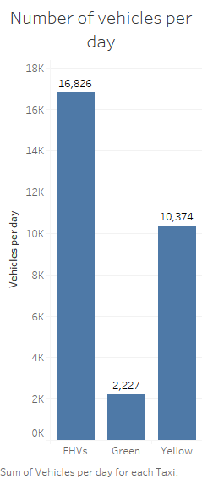
Cruising/ Double parking by Taxi drivers
Approach: Simulation Study (Estimating parameters)
Variation of average trip duration across time and across services
Asymmetry in total number of trips and number of vehicles per day
Estimation of Parameters:
Bookings/min
Trips/min
Queuing theory equivalent of
Rate of arrival – for inter arrival time
Rate of service – Service time
Assume an exponential distribution of booking arrival and service (trip) duration

Slide 9
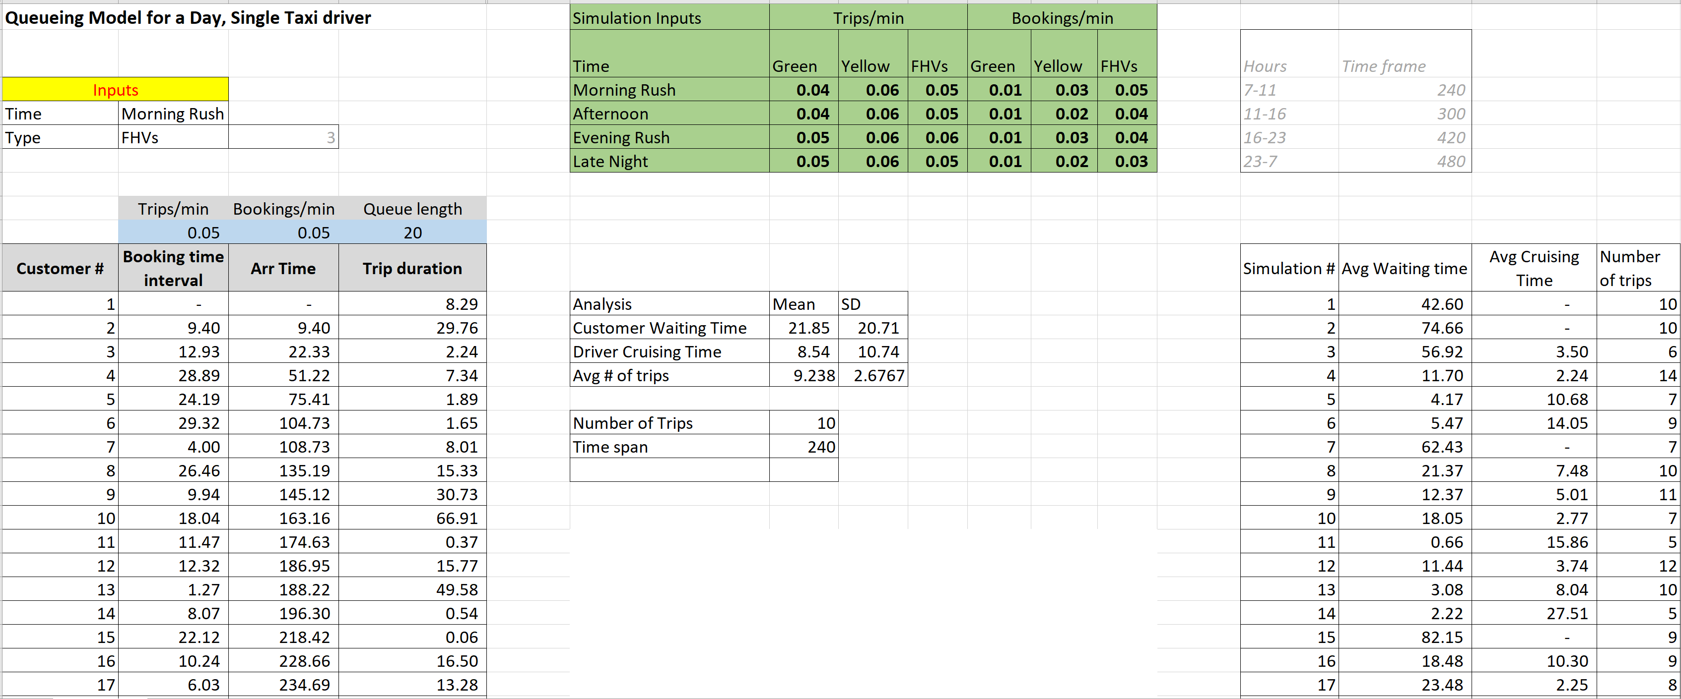
Cruising/ Double parking by Taxi drivers
Approach: Simulation Study to quantify the ‘Cruising time’ of taxi drivers

Slide 10
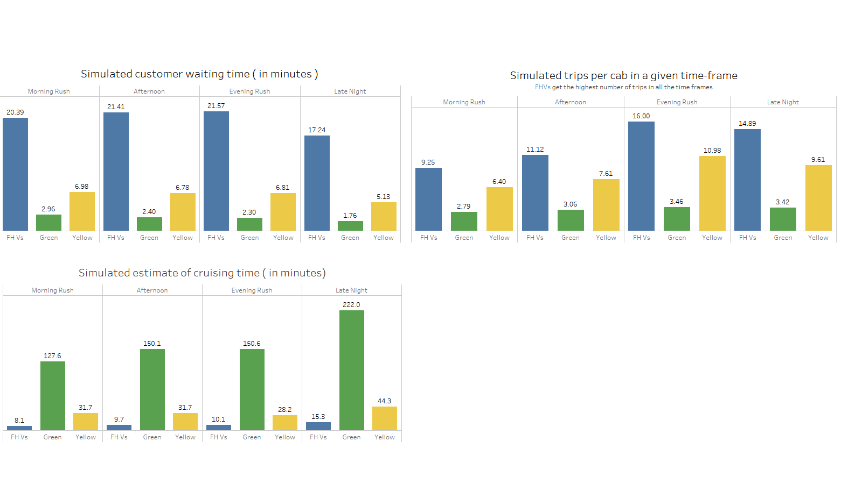
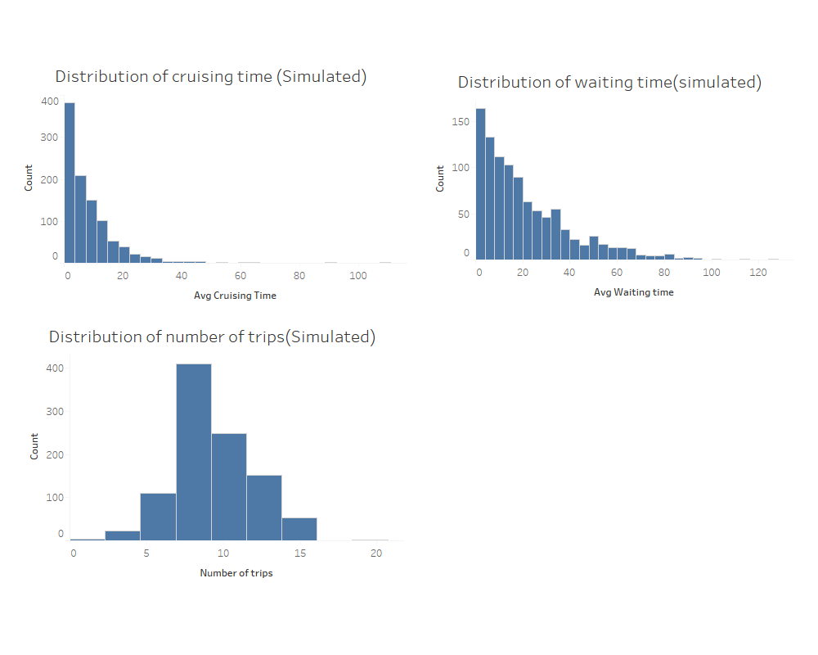
Cruising/ Double parking by Taxi drivers
Simulation Results:
Large difference in cruising time across services
Curse of street hailing vs e-haling

Slide 11
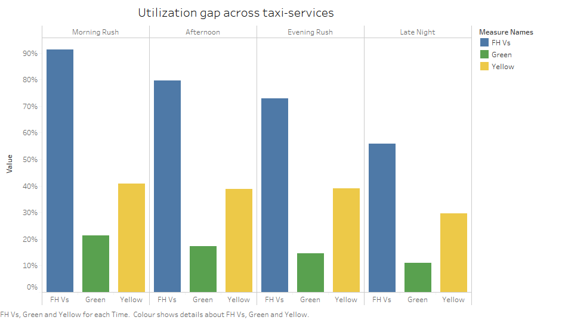
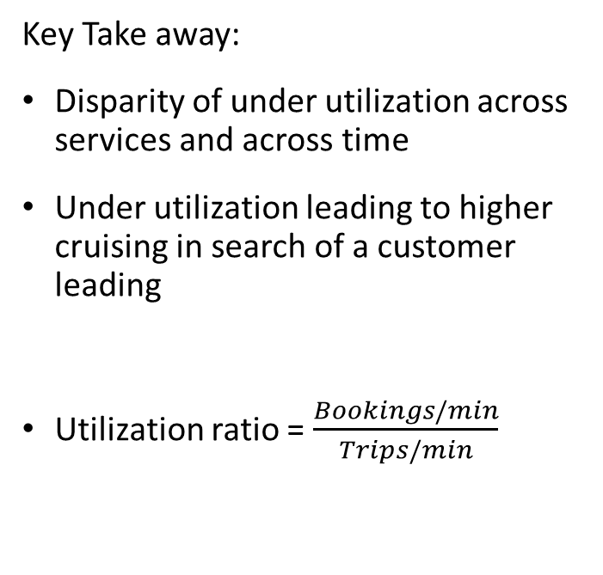
Cruising/ Double parking by Taxi drivers
Key Take away:
Disparity of under utilization across services and across time
Under utilization leading to higher cruising in search of a customer leading
Utilization ratio = $\frac{Bookings/min}{Trips/min}$

Slide 12
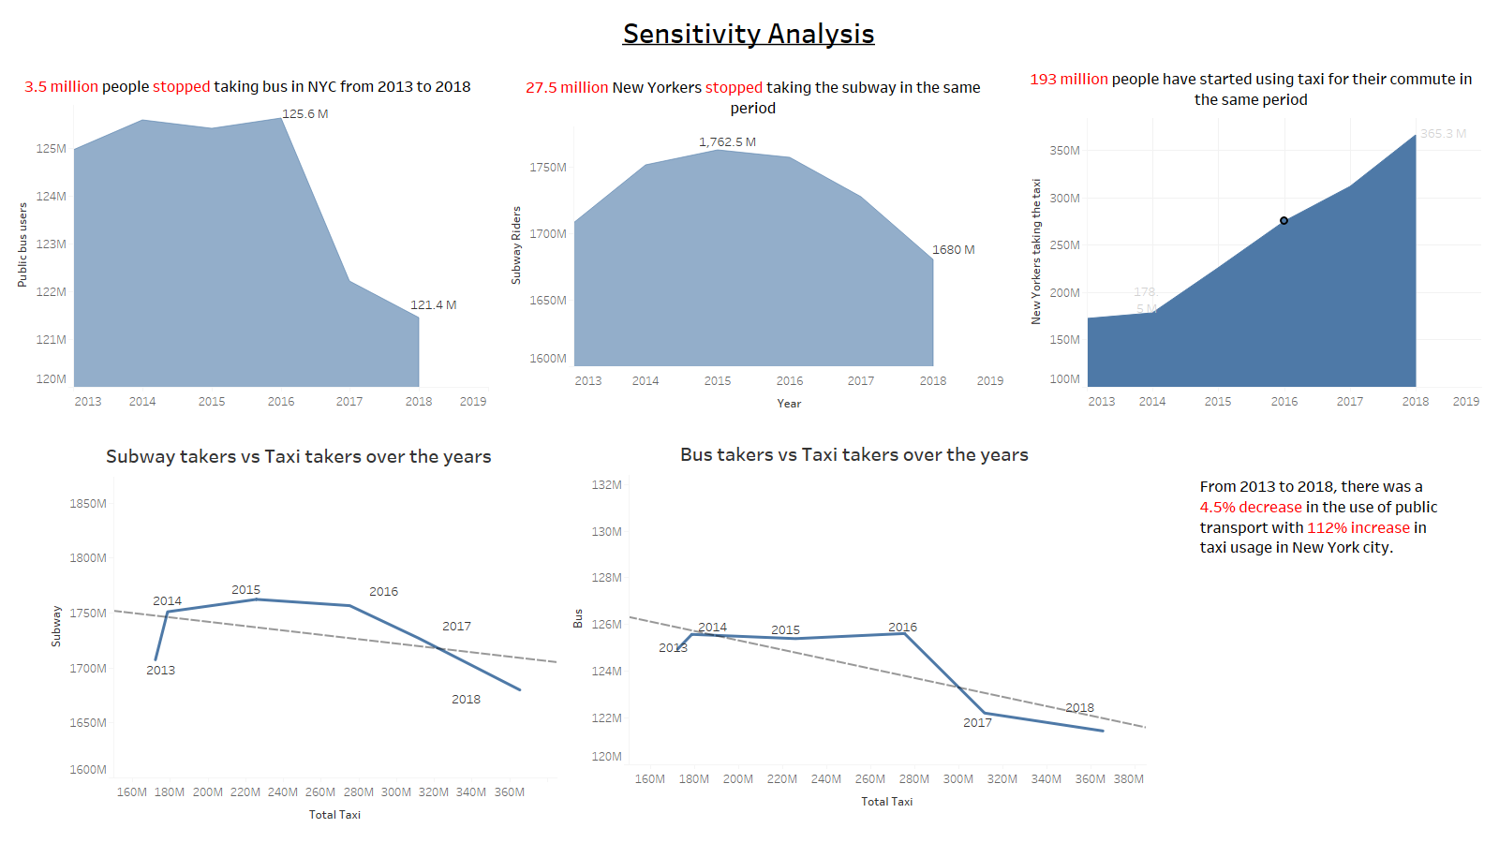
Falling ridership of Mass Transit System
Approach: Correlation & Trend analysis

Slide 13
Approach: Understanding structure of the current market
Trading & ownership of Taxi medallions
Heavy financial losses for owners of medallions
Push for increasing licenses by FHVs such as Uber/Lyft (currently capped at 100,000 per year)
Number of taxi vehicles on road
Notes:
Price of a medallion peaked to over $1 million (2013)
In July 2019, sixteen medallions were auctioned
Three sold for $137,000, $136,000 and $138,000 & the other thirteen had no bidders

Slide 14

Primary cause: Uncoordinated and Inefficient implementation of an ad-hoc, naïve-agent, “Delivery as a Service” feature.
feature.
Inefficiency of scale
No sharing universal fixed costs and activities.
Overlapping “paths” decrease overall quality and utility.
“Cruising” consumes system resources; no output
Conclusions
Notes:
Inefficiency of scale: too many uncoordinated agents consuming both a fixed and limited resource (i.e. time and space on roads)
Current conditions prohibit distributed sharing and abstraction of universal fixed costs and activities.
Overlapping “paths” create congestion decreasing, overall quality and utility.
“Cruising” consumes system resources with no corresponding benefit/utility

Slide 15
Recommendation: Shift commuters to Mass Transit System
Fix issues related to:
Improve connectivity :
Aging infrastructure
Frequent breakdowns
Signal gaps
Rickety tracks
Labour shortage
Better co-ordination between bus routes and subway stations
Improve utilization of yellow & green cabs by deploying them on fixed routes between stations, connecting key drop-off locations
Encourage pooled cab services

Slide 16
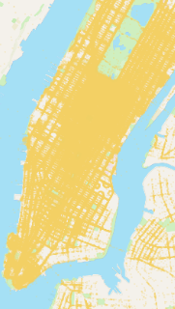
Recommendation: Centralized multistoried Municipal parking structures
FHV’s trip ends
Start moving towards the parking until the next booking
Repeat
Geo-spatial analysis to optimal identify locations for parking structures
IoT devices can help integrate the taxis with TLC’s server to ensure regulations
APIs to Police Department to identify ‘booking status’ and ensure monitoring
Demand forecasting for better distribution of service and lower waiting times

Slide 17
Restructure the current market and introduce a platform for free trade of right to operate taxis
Allocate licenses to each category of taxis
Short term contracts for maintaining liquidity in the system
Compensation of financial losses for medallion holders (share of taxi market)
Examples: Many Municipal transit authorities auction bus routes
Recommendation: Free market trade of short term licenses

Slide 18
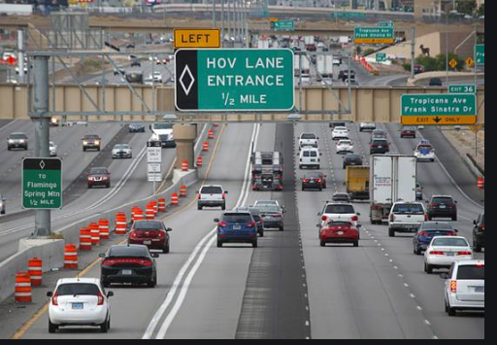
Recommendation :
Creation of a “HOV” lane for major throughways

Slide 19
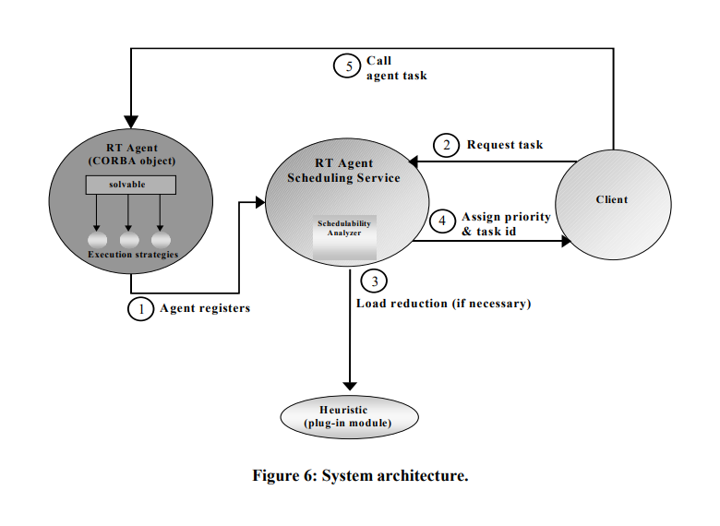
Recommendation : Centralized facilitator service for Manhattan (Object Request Broker)
AAMS Conference, 2009: Multi-Agent Real Time Scheduling System for Taxi Companies
Towards a Real-Time Agent Architecture - A Whitepaper: List DiPippo, Ethan Hodys

Slide 20
Topics for further study
Agent-based Predictive Modelling and Simulation
Better geo-spatial analysis to support optimal implementation

Slide 21
Bibliography
AAMS Conference, 2009: Multi-Agent Real Time Scheduling System for Taxi Companies
Proceedings of the Fifth International Workshop on Object-Oriented Real-Time Dependable Systems, November 1999, Towards a Real-Time Agent Architecture - A Whitepaper: List DiPippo, Ethan Hodys, Bhavani Thuraisingham
A Scheduling Algorithm for a Real-Time Multi-Agent System, 2000: Ethan Hodys
Object Request Broker Architecture: ARNO PUDER, ... FRANK PILHOFER, in Distributed Systems Architecture, 2006
Facilitator Agent Design Pattern of Procurement Business Systems: Faiz M. Al-Shrouf Dept. of Comput. Sci., Appl. Sci. Univ., Amman, 2008 32nd Annual IEEE International Computer Software and Applications Conference

Slide 22
Information sources / references
Public Transport data - https://data.cityofnewyork.us/Transportation/MTA-Data/mmu8-8w8b
Taxi data - https://opendata.cityofnewyork.us/
Uber 2014-15 data - https://fivethirtyeight.com/tag/uber/
Taxi medallions: https://en.wikipedia.org/wiki/Taxi_medallion#cite_note-11
Mass Transit system: https://www.theatlantic.com/technology/archive/2017/07/when-did-new-york-citys-subway-get-so-bad/533502/

